Slide 1
Final Mini Project Demonstration
UE19CS306D
Project Title : Feature Extraction for Paraphrase Detection in a Low Resourced Language : Kannada
Project Guide : Prof. Mamatha H R
Project Team : Anagha H M (PES1UG19CS057)
Karthik Sairam (PES1UG19CS210)

Slide 2
Project Abstract and Scope
Paraphrase detection is a Natural Language Processing classification problem. The main goal of paraphrase identification is to find if two phrases of different lengths are synonymous. This is done by finding the similarity between the given two paraphrases. This paper attempts to preprocess and extract the necessary features required to perform paraphrase detection in Kannada. This is the first few steps done before proceeding to paraphrase identification.

Slide 3
Literature Survey
 | Paper 1 | Paper 2
Title | A Survey on Paraphrase Detection Techniques for Indian Regional Languages | Detection of paraphrases for Devanagari languages using support vector machine
Authors | Srivastava, Shruti & Govilkar, Sharvari | D. S. Bhole and S. S. Patil
Year of Publishing | 2017 | 2018
Inferences | Explains the approach of NLP in English, and provides information on different Paraphrase detection techniques and Similarity Metrics used in NLP. | Details about the feature extraction po of paraphrase detection, including Tokenization, Stop-word elimination, Stemming
Shortcomings | The scope is limited to English only, hence significant changes have to be made to implement a model in a low resourced language like Kannada. | Done for Hindi and Marathi, and since Kannada is significantly grammatically complicated than hindi, a more robust model is required to classify paraphrases.

Slide 4
Literature Survey
 | Paper 3 | Paper 4
Title | Paraphrase plagiarism identification with character‐level features | Paraphrase Detection for Short Answer Scoring
Authors | Sánchez-Vega, F., Villatoro-Tello, E., Montes-y-Gómez, M | Koleva, N., Andrea Horbach, Alexis Palmer, Simon Ostermann and Manfred Pinkal.
Year of Publishing | 2019 | 2014
Inferences | Proposed a model that extracts 6 features for paraphrase detection. Also proposed method for corpus creation. | Two methods - Basic and Chunk phrased ; uni and bi directional. Also extracts 5 features.
Shortcomings | Talks only about specific application implementation. | Done in German.

Slide 5
Literature Survey
 | Paper 5 | Paper 6
Title | A survey on paraphrase recognition. | Hindi Paraphrase Detection using Natural Language Processing Techniques & Semantic Similarity Computations
Authors | Magnolini, Simone | Kanjirangat, Vani & Gupta, Deepa
Year of Publishing | 2014 | 2016
Inferences | Defines Paraphrasing and explains different algorithms/approaches. Comparison between different approaches is given | Tagging, pruning, stop word removal and stemming
Shortcomings | Doesn’t give the exact procedure for doing paraphrase identification. | -

Slide 6
Literature Survey
 | Paper 7 | Paper 8
Title | Paraphrase Detection in Hindi Language using Syntactic Features of Phrase | An Eccentric Approach for Paraphrase Detection Using Semantic Matching and Support Vector Machine
Authors | Bhargava, Rupal & Baoni, Anushka & Jain, Harshit & Sharma, Yashvardhan | P. Vigneshvaran, E. Jayabalan and A. V. Kathiravan
Year of Publishing | 2016 | 2014
Inferences | Stemming and Soundex core used. Error analysis and classifier comparison already done | The approach specified here is Tokenization, POS Tagging, Token Match, Token Count. The features extracted are thus fed to the SVM.
Shortcomings | We can inherently use the best classifier but this is done only for hindi | -

Slide 7
Literature Survey
 | Paper 9 | Paper 10
Title | Paraphrase Detection Using Manhattan's Recurrent Neural Networks and Long Short-Term Memory | A Paraphrase and Semantic Similarity Detection System for User Generated Short-Text Content on Microblogs
Authors | A. A. Aziz, E. C. Diamal and R. Ilyas | Kuntal Dey, Ritvik Shrivastava, Saroj Kaushik
Year of Publishing | 2019 | 2016
Inferences | Converts word to vector. Creates a matrix. Manhattan LSTM offers an approach to common sentence similarity problems. Uses a Siamese Neural Network. | Topic phrase is removed, normalization is performed, boundary correction is done , cleaning and synonym, hypernym are performed
Shortcomings | Extensive process. Training data is huge. | Used traditional classifier. Deep learning would have enabled usage of more features.

Slide 8
Project Requirements
SL. No | Functional Requirements | Non-functional Requirements
1 | Create an appropriate dataset | Clean the sentence pools
2 | Input texts in Kannada | Extract the features from the cleaned data
Notes:
Functional requirements:
Required to create an appropriate dataset, large enough to work well with language processing
Ability to input texts in the Kannada language
Non-functional requirements:
To handle input in the kannada language
To clean the sentence pools
To extract the features from the same

Slide 9
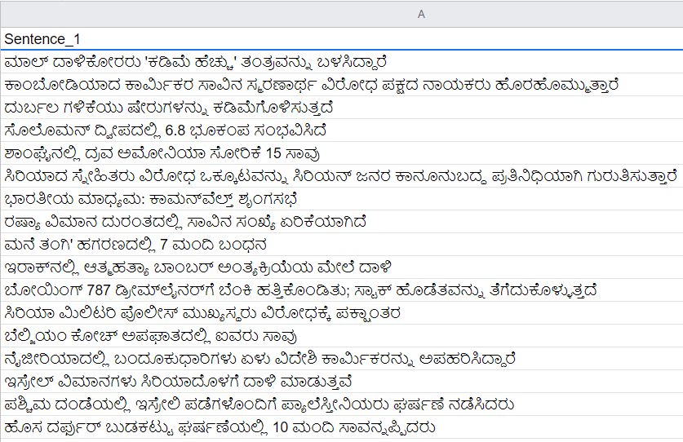
Methodology
Creation of the dataset

Slide 10
Features of the created dataset
Finding an appropriate dataset is indeed challenging due to :
Lack of meaningful datasets in the Kannada language
Lack of datasets containing the structure appropriate for our project
Hence, a dataset was created for the sole purpose of this project. This contained data points in the Kannada language, and the following features:
Over 600 data points
Over 1200 sentence in Kannada
2 Columns, each containing a sentence pool. For a given row, the sentences from the 2 pools might/might not be paraphrases of each other (variedness).

Slide 11

2. Cleaning of
the dataset

Slide 12
3. Feature
Extraction
This involves tokenization and stemming.
Tokenization can be done successfully, and is discussed in later slides.
Stemming is an integral part of feature extraction, and is discussed later.

Slide 13
Technologies Used
Python 3.8
Pandas
Numpy
Regex
INLTK (Indian Natural Language Toolkit)
Notes:
‹#›

Slide 14
Research Questions
Why it is tougher to tokenize the words in Kannada?
English translation of “ in him “ = ಅವನಲ್ಲಿ
The observation:
The same two words are syntactically written as one word in Kannada
We have complex grammar that a language like English, such as :
Sandhi
Vibhakti Prathyaya
Samasa
We need to implement in such a way so as to handle such special cases of the Kannada language.
Notes:
‹#›

Slide 15
Research Questions
2) How can stemming be implemented? Is it necessary?
Stemming is an integral part of “most” NLP tasks
If a document exists with > 10,000 words, probability of having tokens from the same root word is high.
But, paraphrase detection works on just two sentences.
What is probability of having same stems in those 2 sentences?
Very Less and
Negligible
Notes:
‹#›

Slide 16
Algorithm
A general approach to applying the feature extraction:
Begin
For every sentence Si in sentence pool S, do
Tokenize each word in Si such that tokens are both:
Word-based and
Syntactic-based
Repeat Steps 2 and 3 for all sentence pools
End

Slide 17
References
[1] Sarkar, Sandip & Saha, Saurav & Bentham, Jereemi & Pakray, Dr. Partha & Gelbukh, Alexander. (2016). NLP-NITMZ@DPIL-FIRE2016:Language Independent Paraphrases Detection.
[2] Srivastava, Shruti & Govilkar, Sharvari. (2017). A Survey on Paraphrase Detection Techniques for Indian Regional Languages. International Journal of Computer Applications. 163. 42-47. 10.5120/ijca2017913757.
[3] Sánchez-Vega, F., Villatoro-Tello, E., Montes-y-Gómez, M. et al. Paraphrase plagiarism identification with character-level features. Pattern Anal Applic 22, 669–681 (2019). https://doi.org/10.1007/s10044-017-0674-z
[4] Koleva, N., Andrea Horbach, Alexis Palmer, Simon Ostermann and Manfred Pinkal. “Paraphrase Detection for Short Answer Scoring.” (2014).

Slide 18
References
[5] Koleva, N., Andrea Horbach, Alexis Palmer, Simon Ostermann and Manfred Pinkal. “Paraphrase Detection for Short Answer Scoring.” (2014).
[6] Magnolini, Simone. (2014). A survey on paraphrase recognition. CEUR Workshop Proceedings. 1334. 33-41.
[7] Kanjirangat, Vani & Gupta, Deepa. (2016). ASE@DPIL-FIRE2016: Hindi Paraphrase Detection using Natural Language Processing Techniques & Semantic Similarity Computations.
[8] Bhargava, Rupal & Baoni, Anushka & Jain, Harshit & Sharma, Yashvardhan. (2016). BITS_PILANI@DPIL-FIRE2016:Paraphrase Detection in Hindi Language using Syntactic Features of Phrase.

Slide 19
References
[9] P. Vigneshvaran, E. Jayabalan and A. V. Kathiravan, "An Eccentric Approach for Paraphrase Detection Using Semantic Matching and Support Vector Machine," 2014 International Conference on Intelligent Computing Applications, 2014, pp. 431-434, doi: 10.1109/ICICA.2014.94.
[10] A. A. Aziz, E. C. Diamal and R. Ilyas, "Paraphrase Detection Using Manhattan's Recurrent Neural Networks and Long Short-Term Memory," 2019 6th International Conference on Electrical Engineering, Computer Science and Informatics (EECSI), 2019, pp. 432-437, doi: 10.23919/EECSI48112.2019.8976951.

Slide 20
Project Demo
Notes:
‹#›

Slide 21
Queries
Notes:
‹#›

Slide 22
Thank You

